Slide 1
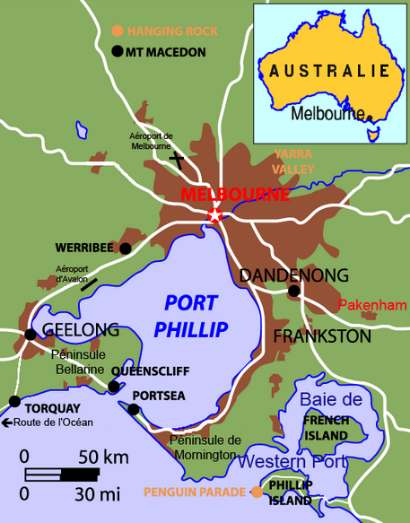
Melbourne housing data

Slide 2
Objective:
We are going to use the Melbourne housing data and try to predict the >>price<< of a house using Supervised Machine Learning algorithms.
Source file:
the data is taken from Kaggle.com and has values for three years: 2016,2017 and 2018

Slide 3
Summary of the analysis
1. A first look to the dataset
2.Data Cleaning
2.1.Missing Values
2.2.Outliers
2.3.Feature Engineering
3. Visualisations
3.1 Boxplot and histogram
3.2 Time Series
3.3 Scatterplot
3.4 Map
4. Machine Learning
4.1 Model Comparison
4.2 Fine Tuning - hyperparameters
a. Random Search
b. Grid Search
4.3 Test set evaluation

Slide 4
1. A first look to the dataset
There are 21 columns and 34857 rows
We have insights about:
- Rooms: 1 to 16
- Price: 85K to 11,2M AUD
- Distance to city center (CBD)
0 – 48 km
- Land Size & Building Area
- Type of a house:
h - house, cottage, villa
t – townhouse
u – unit, duplex
Region Name - General Region (West, North West, North, North east)
Year Built: 1965 - 2018
Latitude and Longitude
Bathrooms and Car spots
0-12 / 0-26
Suburb
Property count: number of properties in the Suburb

Slide 5
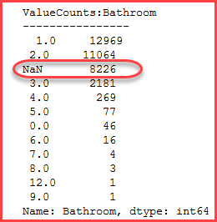
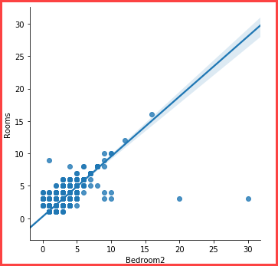
1. A first look to the dataset
As we read the description of each column we see that:
Bathroom, Car are floats but should be integer
Because there are NULL values we’ll wait after fixing that
Postcode is float but we should change it to a category type
Yearbuilt should be an integer
Propertycount should be an integer
Rooms and Bedroom2 seem to represent the same data
Out of 34854 records, only 9162 have different values
From those 9162, 8217 are NULLs which means approximately 90%.

Slide 6
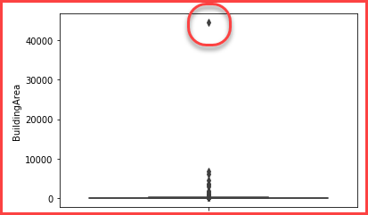
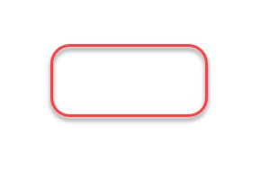

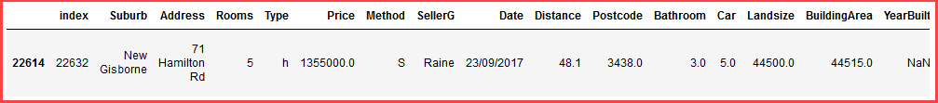
Analyze ‘Building Area’ column
The boxplot shows an outstanding outlier, with a building area of more than 40000 squared meters.
We notice the building has only 5 rooms,
3 bathrooms and the 'BuildingArea' is bigger
than the 'LandSize' it might me an error.
The YearBuilt is also missing.
However this property could be an old factory with lots of land.
We can safely drop this row.

Slide 7
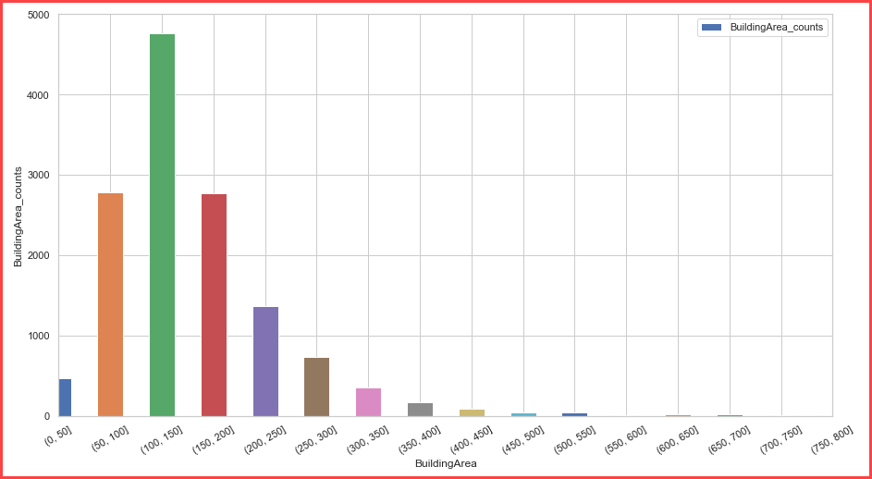
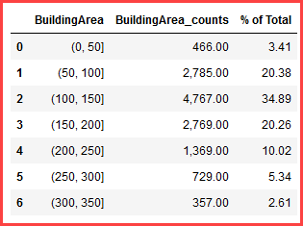
After dropping the most extreme outlier, we can group BuildingArea into bins of ~50 sqm to see on a plot bar how are the houses distributed.
Most of the houses are between 100 and 200 sqm (~55%)

Slide 8
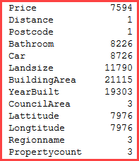
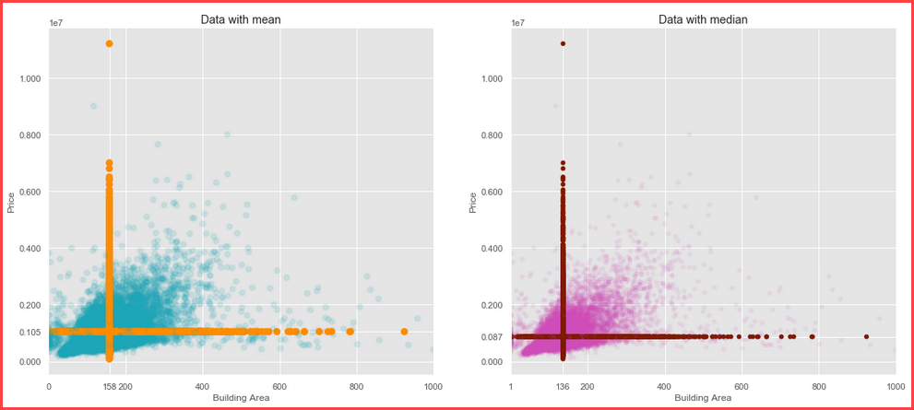
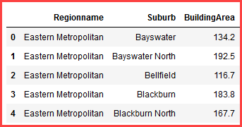
2. Data cleaning
2.1. Missing values
Out of a total of ~34750 rows some features have a lot of NULLs
We’d evaluate whether it is better to impute the missing values with their mean or median.
In both graphs we can see where the imputed values would be.
There is not a striking visual difference between the two graphs. However, after a careful look we can say that:
Price has a lot of outliers, and the median is less affected by them, as the horizontal line in the graph on the right is lower.
Chosen Solution: Impute NULLs in BuildingArea with median from ['Regionname' and 'Suburb']
The median for groups:

Slide 9
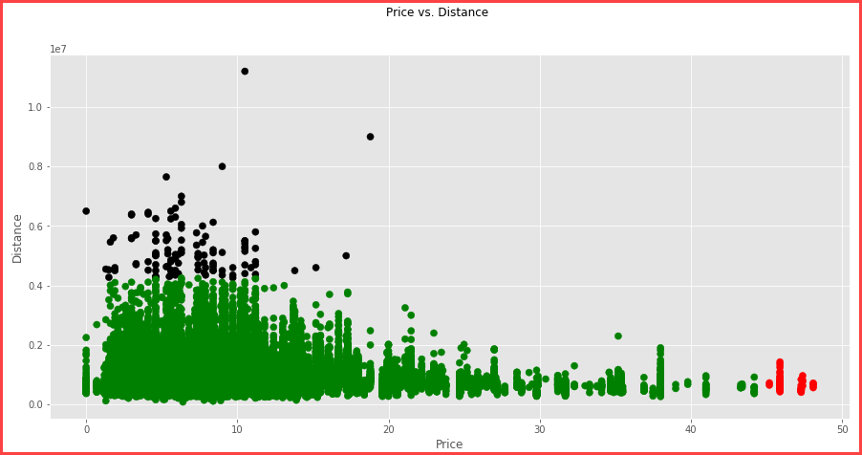
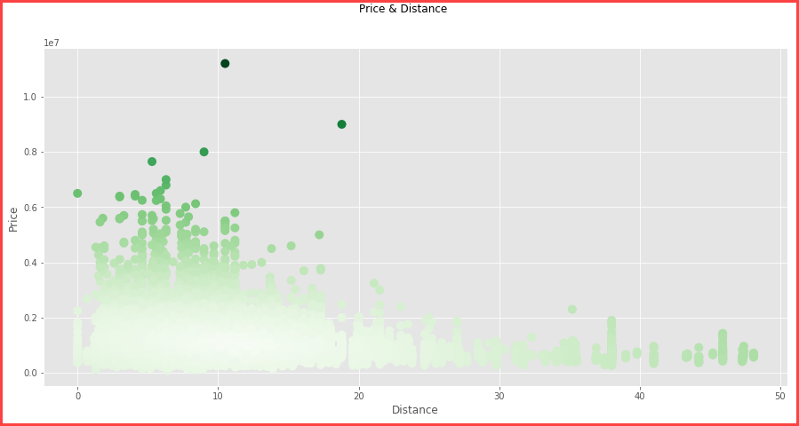
2. Data cleaning
2.2. Outliers
Let’s visualize Price and Distance to spot outliers:
> each point is either an outlier either for price or distance
I chose to keep an extremely high threshold to define outliers: over 5 std,
where 2 or 3 would have been much more common.
Reason: the high prevalence of outliers found in this database.
Graph with Mahalanobis distance in color:
% of Outliers for Price ~= 0.47%
We can see that more "central" points have a low Mahalanobis distance (white points), while those on the outskirts have more saturated colors, i.e., higher distance to the centre.
% of Outliers for Distance ~= 0.2%
In this plot, the only clear 2D outliers are the dark points on the top left corner.

Slide 10
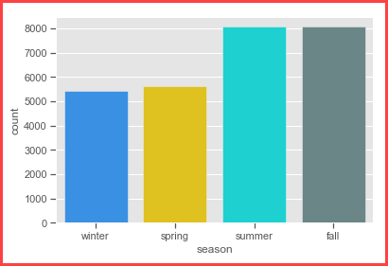
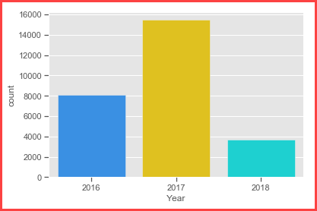
2.3. Feature engineering
Create a new feature from DateSold as Season
and another asYear
Most properties were sold during summer and falls
Most properties were sold in 2017

Slide 11
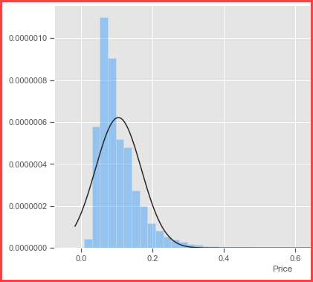
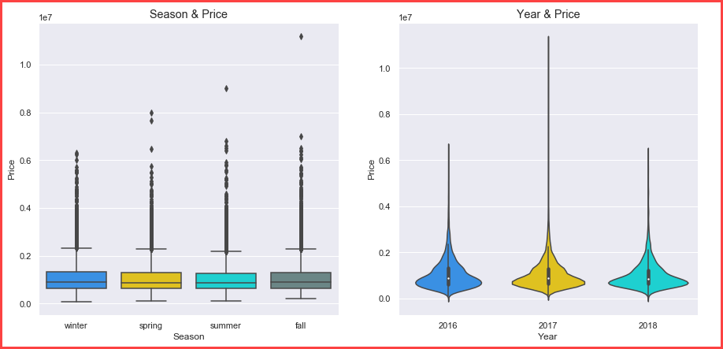
3. Visualizations
3.1. Boxplots and Histograms
The Price histograms shows right skewness towards big values.
The sold price during season is similar with some outliers
2017 was indeed a better year with some outliers

Slide 12
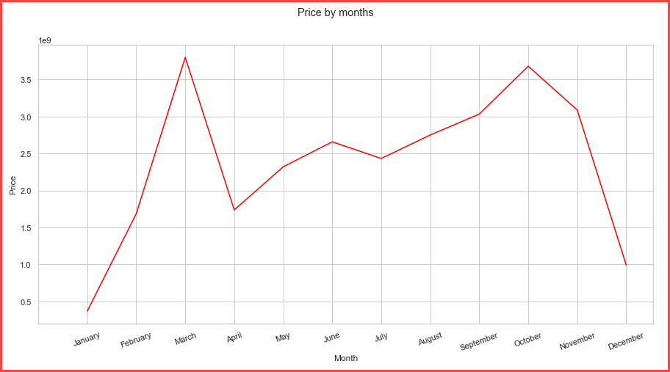
3. Visualizations
3.2. Time Series
Considering the size of the dataset I expected to have house sales for almost every day.
Unexpectedly, out of all the 2 and a half years, houses were sold only during 78 days
We can also see how were distributed the sales M-by-M without the year value:

Slide 13
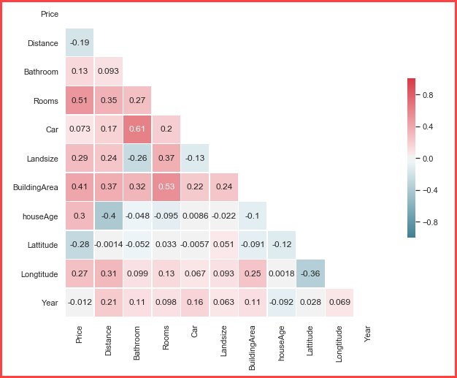
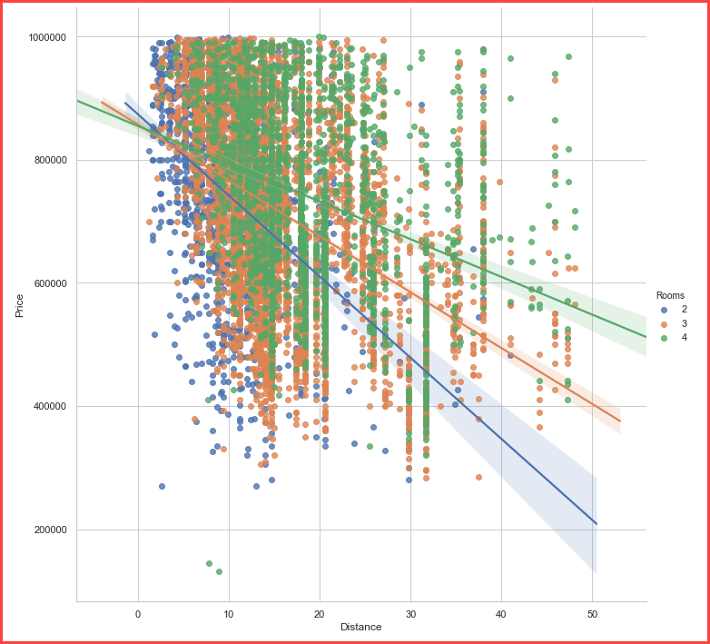
3.3. Correlation matrix and scatterplots
Let us look at the correlations between our variables, first with a correlation matrix.
As we move further from CBD the price decreases with different rates depending on how many rooms the house has

Slide 14
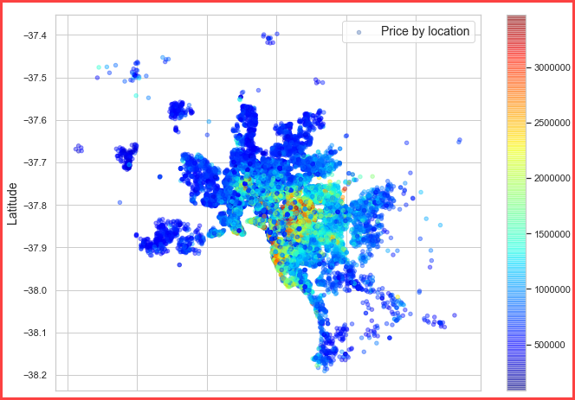
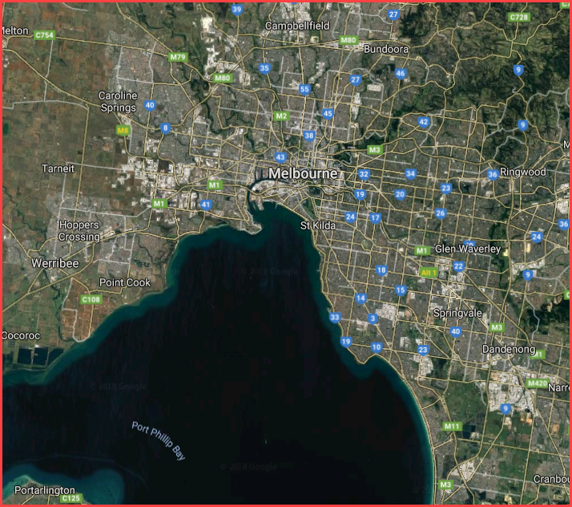
3.4. Geographical Data
After removing some outliers that were turning the data to blue only, we can see that closer to the CBD are the most expensive houses.

Slide 15
Machine learning
4. Machine Learning
4.1 Model Comparison
4.2 Fine Tuning - hyperparameters
a. Random Search
b. Grid Search
4.3. Evaluate best model on the test set

Slide 16
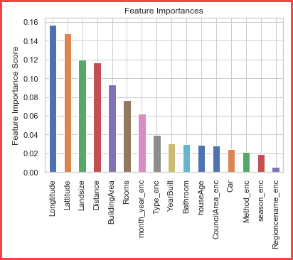
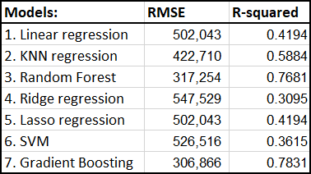
4. Machine Learning
4.1 Model Comparison
Feature importances with Random Forest:

Slide 17
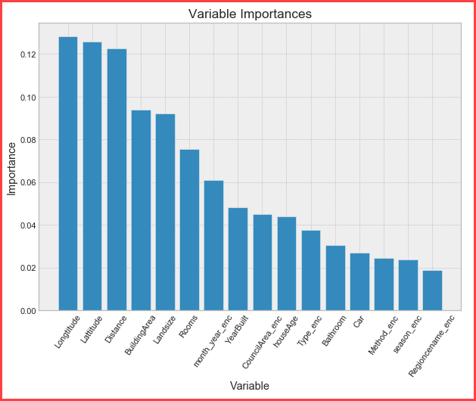
Feature importance with GBM:
A future aim may be to cut the less relevant features (let's say everything after ‘houseAge' in terms of importance), estimate a new model and compare it with the old ones. I reckon it would lose predictive power, but on the other hand it would gain in terms of training speed
* the best feature to reliably predict the price of a
Melbourne house are actually 3: Lat&Long + Distance
* ‘BuildingArea’&’Landsize’ come second and are equal
>> Location and property size are weighing the most
* ‘Rooms’ are far ahead of ‘houseAge’ and ‘Type’
* ‘mont_year’ when house was sold was also important
* Interesting is ‘YearBuilt’ is not as important as we may think

Slide 18
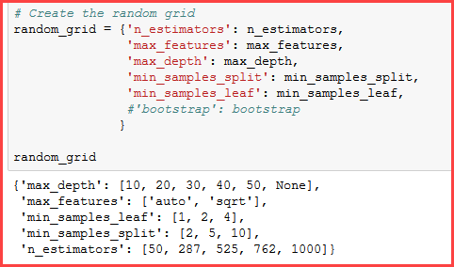
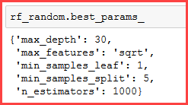
4. Machine Learning
4.2 Fine Tuning - Hyperparameter tuning
- hyperparameters is like the settings of an algorithm that can be adjusted to optimize performance
The randomized search and the grid search explore exactly the same space of parameters. The result in parameter settings is quite similar, while the run time for randomized search is drastically lower.
a. Random Search - we can define a grid of hyperparameter ranges, and randomly sample from the grid, performing K-Fold CV with each combination of values.
Random Forest - Hyperparameter tuning:

Slide 19
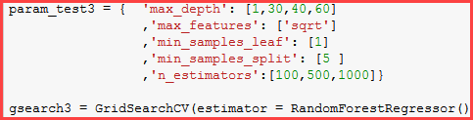


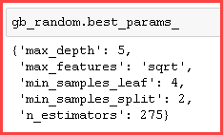

4. Machine Learning
4.2. Fine Tuning:
b. Grid Search - Now that we know where to
concentrate our search we can narrow down the range for each
hyperparameter.
Gradient Boosting - Hyperparameter tuning
n_estimators = number of trees in the foreset
max_features = max number of features considered for splitting a node
max_depth = max number of levels in each decision tree
min_samples_split = min number of data points placed in a node before the node is split
min_samples_leaf = min number of data points allowed in a leaf node
bootstrap = method for sampling data points (with or without replacement)
Results with RandomizedSearchCV and with GridSearchCV

Slide 20
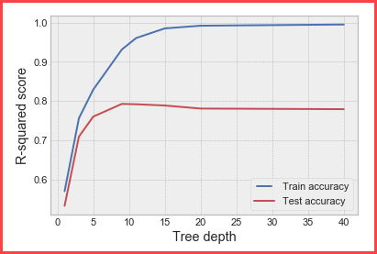
4. Machine Learning
4.3. Evaluate best model on the test set
As the time spent to tune parameters is significant I chose for us to see how the performance varies when we increase ‘max_depth’
With this graph it is really easy to see where the overfitting
begins: after ~9 splits the test performance does not
increase anymore, while the train stops increasing after
20 splits.
Future steps:
Work with categorical features to create dummies instead of
using LabelEncoder;
Change ‘Rooms’ and ‘Car’ features to categorical type;
Remove some more outliers to see how the model performs;
THANK YOU !

